Slide 1
Vaccine Risk Analysis of VAERS Reports for Vaccine Safety Assessment
DATA 606 Capstone in Data Science
Under the guidance: Unal Sakoglu
Presented by:
Sri Spoorthy Nadella
Sarath Chandra Vundavalli
Sree Sai Sankalp Jagadam

Slide 2
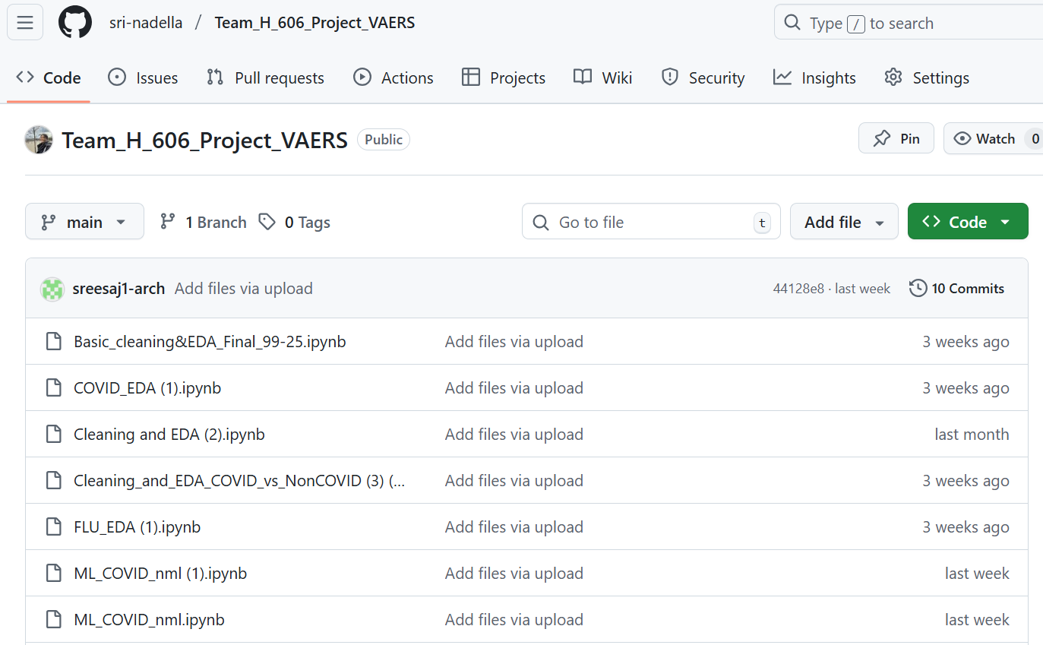
TEAM GITHUB :
https://github.com/sri-nadella/Team_H_606_Project_VAERS

Slide 3
INTRODUCTION
For many years, vaccines have been an important part of public health, preventing millions of diseases and saving countless lives. Strong vaccine safety monitoring is more important than ever, though, especially as vaccination efforts pick up steam, especially than ever in the wake of global crises like the COVID-19 pandemic.
Our project, addresses this need by leveraging advanced data science techniques to analyze adverse events associated with four key vaccines:
Pneumococcal Polysaccharide Vaccine (PPV)
COVID-19 Vaccine
Influenza Vaccine
Varicella Zoster Vaccine
In Phase 3, we focus on:
– Training per-vaccine CatBoost models for Serious vs Non-Serious classification – Evaluating model performance – Deploying VaxShield, a Streamlit chatbot + dashboard.

Slide 4
DATA DESCRIPTION
The Vaccine Adverse Event Reporting System (VAERS) is a crucial tool for monitoring vaccine safety in the United States.
Data source: VAERS data link
It consists of 3 CSV files per year, we are taking the data from (2015-2025):
1.VAERSDATA.CSV: Contains demographic and AE information
2. VAERSVAX.CSV: Vaccine-specific data
3. VAERSSYMPTOMS.CSV: Detailed symptom information
Time frame: 2015–2024 (specify exact years you used in notebooks).
Merged dataset (after cleaning & filtering):
– ~<N> reports (all vaccines) – ~<M> reports for the four focus vaccines (COVID, VARZOS, PPV, FLU) – ~47+ columns → subset of features selected

Slide 5
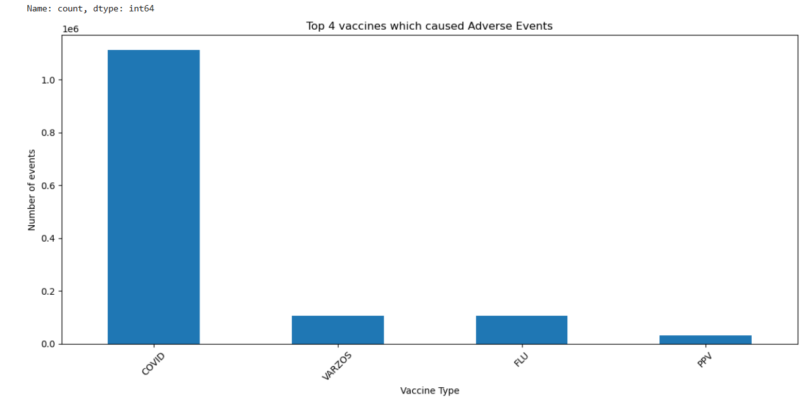
What data are we working on?
Time Frame: Analyzed data from 2015 to 2025.
Focus Area: Concentrated on the number of adverse event reports related to vaccines.
Vaccine Selection: Identified 4 vaccines with the highest number of reported adverse events.
Conducted detailed analyses for each of the selected vaccines.

Slide 6
FEATURE SELECTION
Target Variable Creation- Defining Serious Criteria
1. Death
2. Life Threatening
3.Hospitalization
Is the patient died?
Is the adverse event life threatening?
Is the patient Hospitalised?
4. Disability or Permanent Damage
5. Birth Defect
6. Other Important Medical Terms
Did the patient have any birth defect?
Does the adverse event lead to patient death?
Are the symptoms matching with any IME terms?

Slide 7
Flowchart for target variable
DIED
L_THREAT
BIRTH_DEFECT
HOSPITAL
DISABLE
TARGET VARIABLE
“SERIOUS”
IME
SERIOUS
SYMPTOM 1
SYMPTOM 2
SYMPTOM 3
SYMPTOM 4
SYMPTOM 5

Slide 8
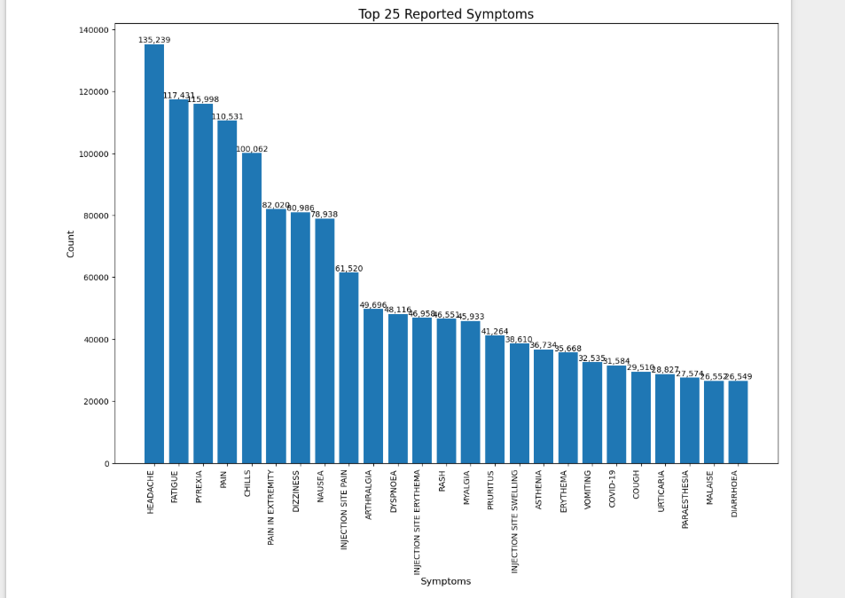
TOP 25 REPORTED SYMPTOMS

Slide 9
DATA MODELING

Slide 10



MACHINE LEARNING MODEL DEVELOPMENT
Objective: Build a predictive model to classify adverse vaccine events as "serious" or "non-serious.“
Challenges: Data Imbalances such as fewer serious cases compared to non-serious ones.
Mixed Data Types: Text columns (symptom descriptions, medical history) and numeric columns (age, hospitalization status).
Vectorizer
Pipeline with ML
Split Data
Evaluation
For Textual columns, we applied TFIDF Vectorizer
Created pipeline with ML algorithms and vectorizer

Slide 11
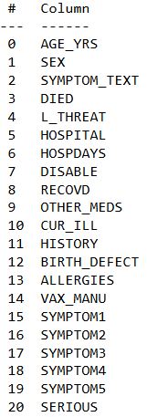
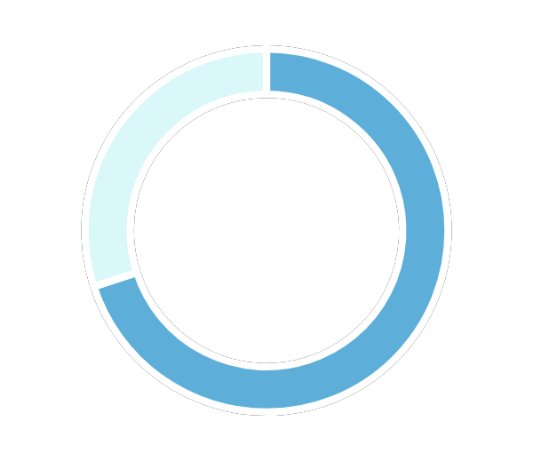
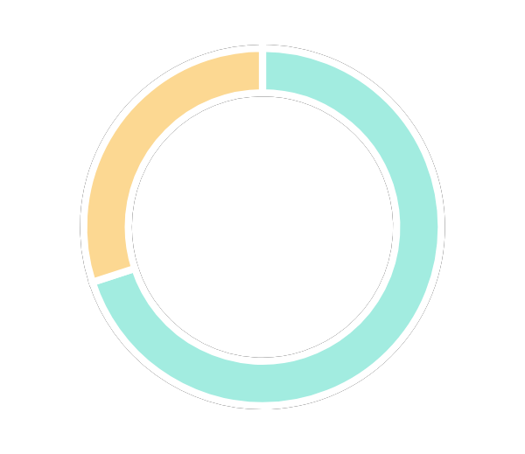
Train and Test Split
70%
30%
Train
Test
# Defining variables
Y = df.SERIOUS
X = df.drop(['SERIOUS','SYMPTOM1','SYMPTOM2’,
'SYMPTOM3','SYMPTOM4', 'SYMPTOM5','VAX_MANU'], axis=1)

Slide 12
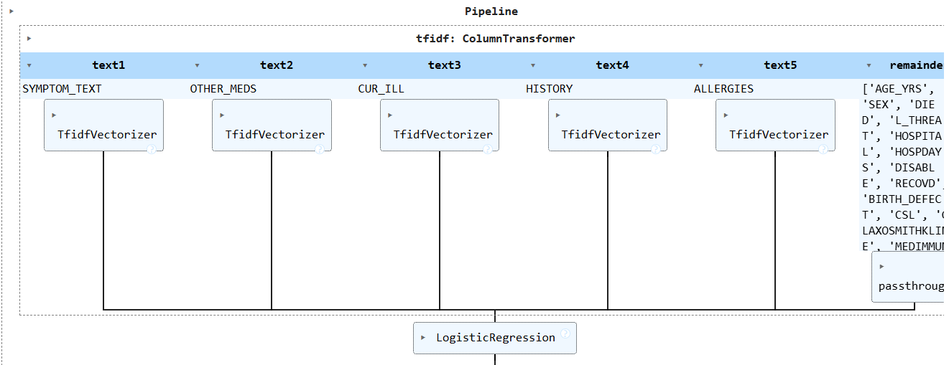
Pipeline For TFIDF
Used TF-IDF (Term Frequency-Inverse Document Frequency) to convert text fields into numeric features.
Used StandardScaler to normalize numeric columns for model compatibility.
Custom stopwords added to remove irrelevant terms (e.g., "vaccine," "patient").

Slide 13
Machine Learning Models
Logistic Regression
Random Forest Classifier
XGBoost Classifier

Slide 14
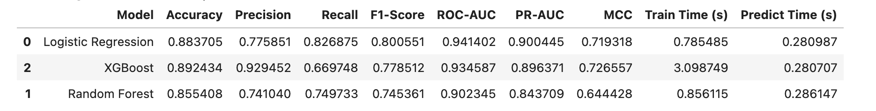
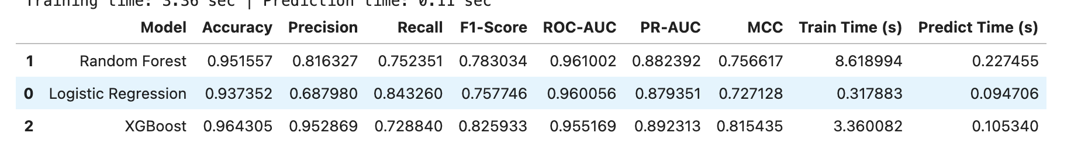
MODEL EVALUATION
COVID
PPV

Slide 15
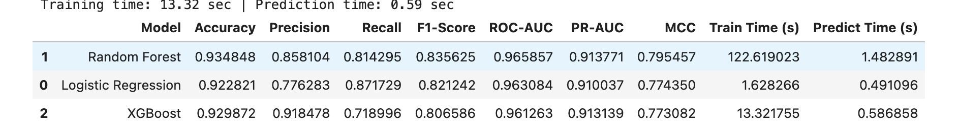
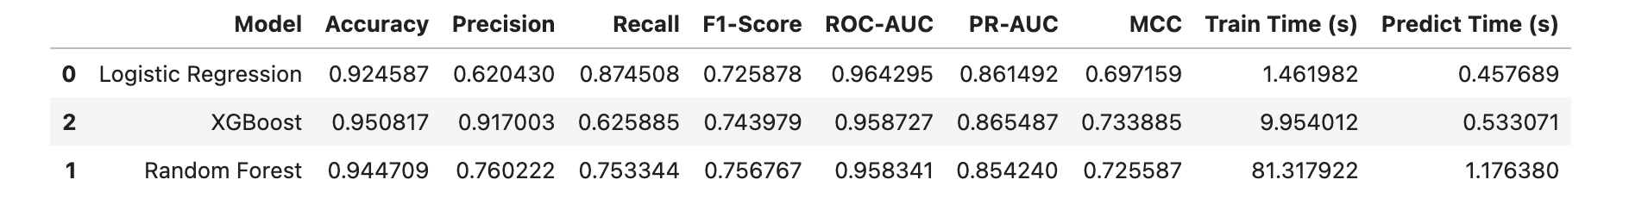
MODEL EVALUATION
FLU
VARZOS

Slide 17
THANKS!!

